Slide 1

Qiskit Aqua Algorithms and Applications
Marco Pistoia, Christa Zoufal IBM Research
https://qiskit.org/aqua

Slide 2
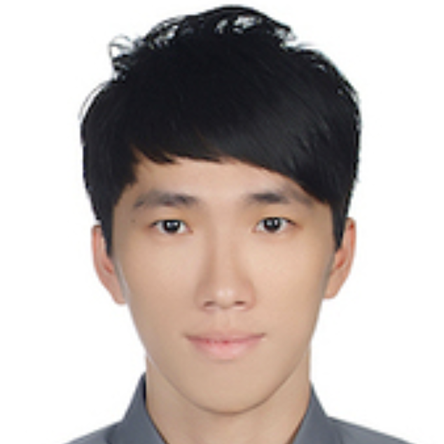
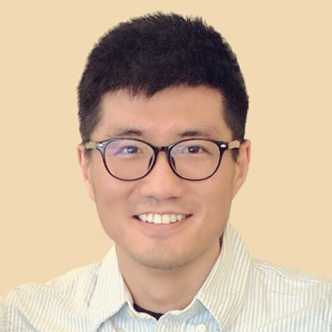

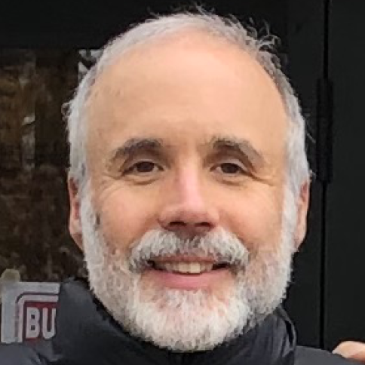

The Aqua Team
Marco Pistoia
Richard Chen
Shaohan Hu
Peng Liu
Manoel Marques
Steve Wood

Slide 3
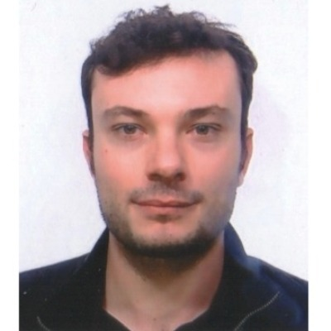

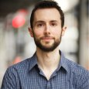


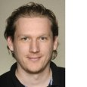
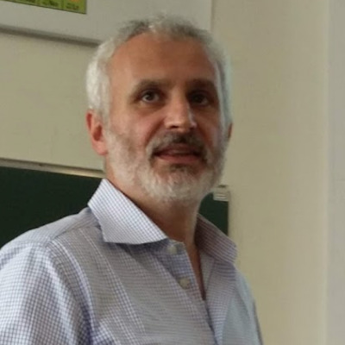
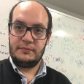
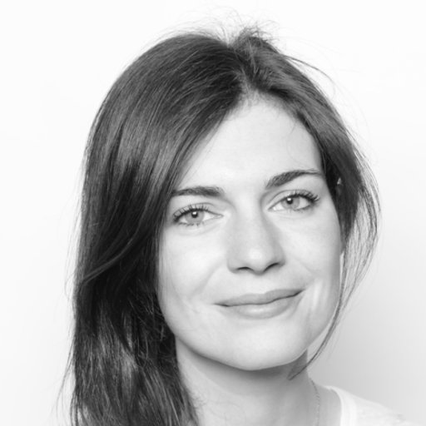
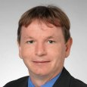
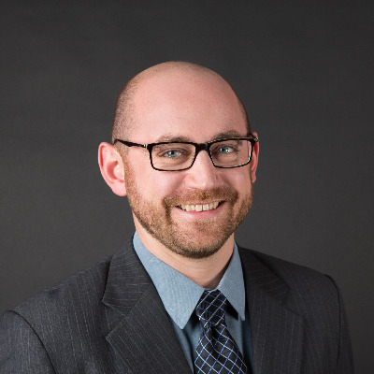
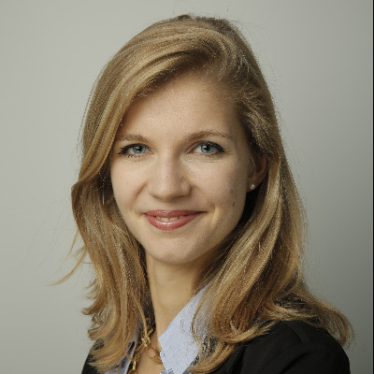
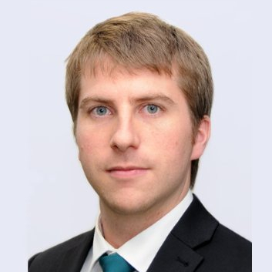

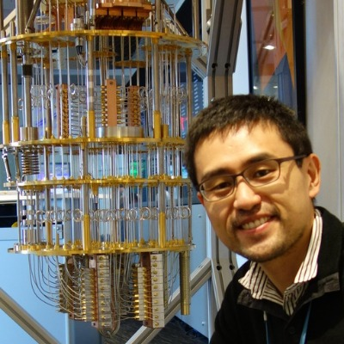
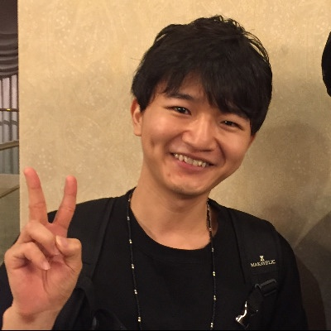
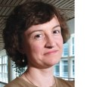

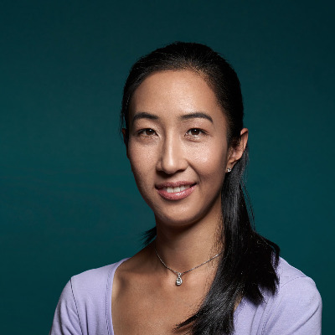
Yorktown Heights
Antonio Mezzacapo
Sergey Bravyi
Giacomo Nannicini
Donny Greenberg
Jennifer Glick
Antonio Córcoles
Jay Gambetta
Zurich
Ivano Tavernelli
Panagiotis Barkoutsos
Pauline Ollitrault
Nikolaj Moll
Stefan Wörner
Christa Zoufal
Daniel Egger
Tokyo
Almaden
Boeblingen
Melbourne
Raymond Rudy
Takashi Imamichi
Atsushi Matsuo
Julia Rice
Albert Frisch
Anna Phan

Slide 4
Qiskit Aqua: Algorithms and Applications
Chemistry
Ground State Energy Dipole Moment Excited States
Finance
Portfolio Optimization
Risk Analysis Pricing
AI
Training Classification
Optimization 3SAT
MaxCut
TSP
Graph Partition
Stableset
Clique
Exact Cover
Set Packing
Vertex Cover
Quantum Algorithms
VQE
QAOA
Dynamics
QPE/IQPE
Amplitude Estimation
Grover
SVM Q Kernel
SVM Variational
Simon
Deutsch-Josza
Bernstein-Varizani HHL

Slide 5
Modularity and Extensibility of the Aqua Library
Initial
State
Variational Form
Optimizer
VQE
Multiclass Classifier
Feature Map
QSVM Kernel
Initial
State
Variational Form
Optimizer
VQKE
Initial
State
Variational Form
Optimizer
Multiclass Classifier
Feature Map
QSVM Variational
Initial State
Optimizer
QAOA
Initial
State
Phase Estimation Circuit
Quantum Fourier Transform
Phase Estimation
Oracle
Grover
Initial
State
Phase Estimation Circuit
Quantum Fourier Transform
Approx. Phase Estimation
Oracle
Deutsch-Josza
Initial
State
Iterative Phase Estimation
Oracle
Bernestein-Vazirani
Initial
State
Phase Estimation Circuit
Quantum Fourier Transform
Random Distribution
Uncertainty Problem
Amplitude Estimation
Oracle
Simon
Initial
State
Phase Estimation Circuit
Quantum Fourier Transform
Reciprocals
Eigenvalues
HHL
Algorithms
Variational Quantum Eigensolver K Eigenvalue Decomposition QAOA Grover Deutsch-Josza Bernstein-Vazirani Simon SVM Q Kernel SVM Variational Phase Estimation Approximate Phase Estimation Iterative Phase Estimation Amplitude Estimation
Optimizers
Local | Global
Nelder-Mead Powell CG TNC SLSQP COBYLA SPSA L-BFGS-B P-BFGS | Direct-L Direct-L-Rand CRS2-LM ISRES ESCH
Variational Forms
RyRz Ry SwapRz UCCSD
Feature Maps
Pauli Expansion Pauli Z Expansion First Order Expansion Second Order Expansion
Random Distributions
BernoulliDistribution LogNormalDistribution MultivariateDistribution MultivariateNormalDistribution MultivariateUniformDistribution NormalDistribution UniformDistribution UnivariateDistribution
Uncertainty Problems
FixedIncomeExpectedValue, EuropeanCallExpectedValue EuropeanCallDelta
Qubit Mappings
Jordan-Wigner Parity Braviy-Kitaev Bravyi-Kitaev Super Fast
Initial States
Zero HartreeFock Custom
Multiclass Extensions
All Pairs One Against All Error-correcting Code
Oracles
Logic Expression Oracle Truth Table Oracle
Chemistry Drivers
Gaussian PSI4 PySCF PyQuante HDF5
QFTs/IQFTs
Standard Approximate
Eigenvalues
Eigenvalues for QPE
Reciprocals
Long Division Lookup Rotation

Slide 6
How to Get the Code and Contribute
https://github.com/Qiskit/qiskit-aqua (pip install or clone)
Algorithms
AI
Optimization
Finance
https://github.com/Qiskit/qiskit-chemistry (pip install or clone)
Chemistry
https://github.com/Qiskit/qiskit-tutorials (clone)
Algorithms
AI
Chemistry
Optimization
Finance
https://qiskit.org/aqua

Slide 7

Qiskit Chemistry
Chemical Configuration
Two-body integrals in MO basis
Driver execution
[[[[6.73630125e-01 2.22044605e-16]
[3.05311332e-16 6.62687200e-01]]
[[2.28983499e-16 1.81541086e-01]
[1.81541086e-01 1.38777878e-16]]]
[[[1.73472348e-16 1.81541086e-01]
[1.81541086e-01 5.55111512e-17]]
[[6.62687200e-01 1.11022302e-16]
[1.11022302e-16 6.96566757e-01]]]]
Chemistry
h2 molecule
0 1
H 0.0 0.0 0.0
H 0.0 0.0 0.2
End Users and Domain Experts
Input Generation
PSI4
PySCF
PyQuante
One-body integrals in MO basis
Dipole integrals
Molecular orbital coefficients
Hartree-Fock energy
Nuclear repulsion energy
Gaussian
HDF5
Drivers
Quantum Input Generation
Driver-independent input
[[-1.24974950e+00 -4.44089210e-16]
[-2.08166817e-16 -4.78751850e-01]]
Translator
API
Qubit Operator
&HAMILTONIAN
TYPE=FULL
TRANSFORMATION_TO_SPIN=PARITY
&END
&QUANTUM_METHOD
NAME_Q_METHOD=VQE
&END
IIII -0.810547986276
ZIII 0.172183942731
ZZII -0.225753502515
IZZI 0.172183942731
IIZZ -0.225753502515
IZII 0.120912633586
ZZZI 0.168927540489
XZXI -0.045232799795
XIXZ 0.045232799795
XIXI 0.045232799795
XZXZ -0.045232799795
ZIZZ 0.166145433380
ZIZI 0.166145433380
ZZZZ 0.174643431424
IZIZ 0.120912633586
Operator
Fermionic Hamiltonian
Qubit Hamiltonian
Quantum Configuration
Domain-independent input
OpenQASM Circuit Representation
Qiskit Aqua
Final Energy
API
OPENQASM 2.0;
include "qelib1.inc";
qreg q[4];
creg c[4];
barrier q[0],q[1],q[2],q[3];
cz q[0],q[1];
cz q[0],q[2];
cz q[0],q[3];
cz q[1],q[0];
cz q[1],q[2];
cz q[1],q[3];
cz q[2],q[0];
cz q[2],q[1];
cz q[2],q[3];
cz q[2],q[3];
cz q[2],q[3];
cz q[3],q[0];
cz q[3],q[1];
cz q[3],q[2];
ry(1.602180515741816) q[0];
rz(2.101578398242260) q[0];
ry(-1.946373587370641) q[1];
rz(0.758362974519232) q[1];
ry(-0.321568447820939) q[2];
rz(0.735401474544032) q[2];
ry(-3.985472706467653) q[3];
rz(-3.621896879029687) q[3];
barrier q[0],q[1],q[2],q[3];
cz q[0],q[1];
cz q[0],q[2];
cz q[0],q[3];
cz q[1],q[0];
cz q[1],q[2];
cz q[1],q[3];
cz q[2],q[0];
cz q[2],q[1];
cz q[2],q[3];
cz q[2],q[3];
cz q[2],q[3];
cz q[3],q[0];
cz q[3],q[1];
cz q[3],q[2];
ry(-1.956365394733121) q[0];
rz(2.782434917882929) q[0];
ry(2.165512585508974) q[1];
rz(-2.665809160889736) q[1];
ry(2.904098438162670) q[2];
rz(-1.120689215841314) q[2];
ry(5.094050467440653) q[3];
rz(-2.615735023496133) q[3];
barrier q[0],q[1],q[2],q[3];
Algorithm Researchers and Developers
Consecutive identical CZ gates optimized out by the Qiskit Transpiler
VQE
QAOA
Dynamics
QPE/IQPE
Amplitude Estimation
Grover
SVM Q Kernel
SVM Variational
Simon
Deutsch-Josza
Bernstein-Varizani
HHL
0.16473420637865788
Algorithms
Optimizers
Var Forms Initial States
Oracles QFTs/IQFTs
Multiclass Ext
Feature Maps Random Dist.
Uncert. Probl.
Reciprocals
Eigenvalues
Ground-state Molecular Energy
Dipole Moment
Excited States
Quantum Researchers and Developers
Quantum Computation
Terra
API
Quantum Experimentalists
Hardware
Simulator

Slide 8
Qiskit Artificial Intelligence
Qiskit Optimization
Algorithms:
SVM Q Kernel
SVM Variational
Problems being solved:
Training
Classification
Algorithms:
Grover
VQE
QAOA
Problems being solved:
3SAT
MaxCut
TSP
Graph partition
Stableset
Clique
Exact cover
Set packing
Vertex cover
Qiskit Finance
Algorithms:
Amplitude Estimation
VQE
QAOA
Problems being solved:
Risk Analysis
Pricing
Portfolio Optimization

Slide 9

Classical Support Vector Machines
Suppose we want to classify a set of $d$-dimensional data points with unknown labels from
Support vectors
We have access to a training set T with known labels
Maximize the margin
Task
find a hyperplane that separates the data, and where the margin is maximized.
What if the data is not linearly separable?
Hyperplane

Slide 10

Quantum SVM algorithms arXiv:1804.11326
Data cannot be typically separated by a hyperplane in its original space
Apply a non-linear transformation function to the data: a feature map
Compute the kernel: collection of inner products of each pair of data points in the new feature space
Computing the kernel may not be efficient classically
Variational method optimizing a parameterized quantum circuit to provide a solution that cleanly separate the data: SVM Variational
Direct estimation of the kernel in the feature space: SVM Q Kernel
Training
Variational: optimizer is ran on data for which the labels are known to find the optimal set of parameters
Kernel: kernel is calculated and the support vectors obtained
Testing or Classification
New labeless data is classified according to the solution found in the training phase

Slide 11
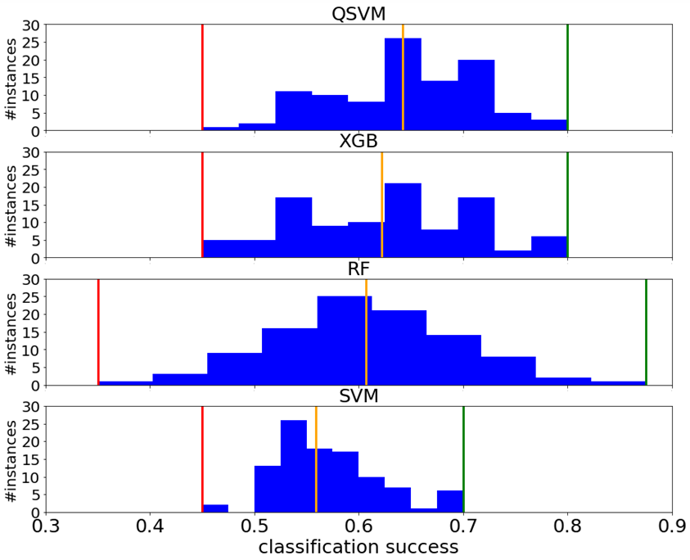
Quantum SVM algorithms – example credit scoring
Objective
Identify bonds for potential investment
Line of business: wealth management
Motivation
Active fixed-income portfolio management
Minimize reliance on credit rating agencies
Quantum finance demonstrator
Classify bonds based on financial statements and existing ratings
Learn existing rating mechanism to rate new bonds
Could be extended to preempt rating changes

Slide 12
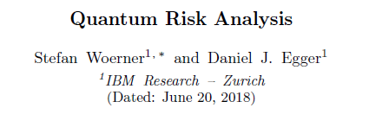
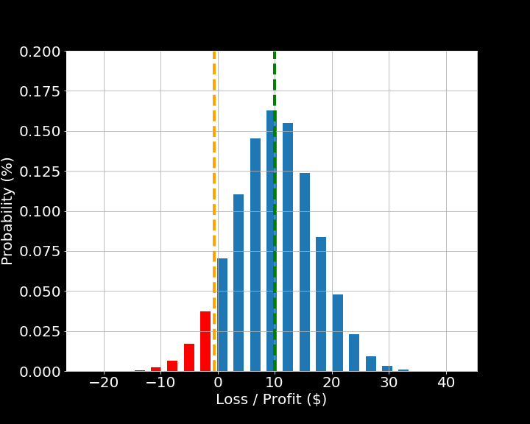
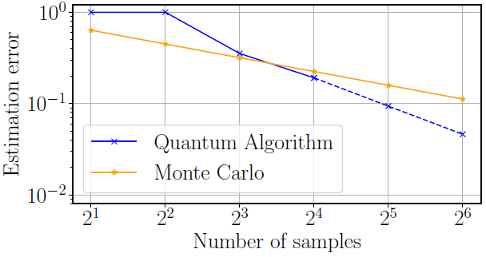
Risk analysis
Probability = 95%
Nature partner journals – Quantum Information 5, 15 (2019)
Probability
Quantum algorithm for pricing & risk analysis
Quadratic speed-up compared to Monte Carlo:
Demonstrated on real quantum device
Loss / Profit ($)
Goal
Estimate
Expected Value
Value at Risk (e.g. 95%)
Conditional Value at Risk (e.g. 95%)

Slide 13
Quantum risk analysis
Probability = 95%
Given: Loss / Profit Distribution of Portfolio
Goal: Estimate
Expected Value
Value at Risk (e.g. 5%)
Conditional Value at Risk (e.g. 5%)
$10
Classical Approach:
Monte Carlo Simulation with samples
Error scales as 1/√M
Error / 10 ➔ M * 100
Quantum Approach:
Based on Amplitude Estimation
Error scales as 1/M
Error / 10 ➔ M * 10
$-1
Quadratic Speedup
$-4

Slide 14
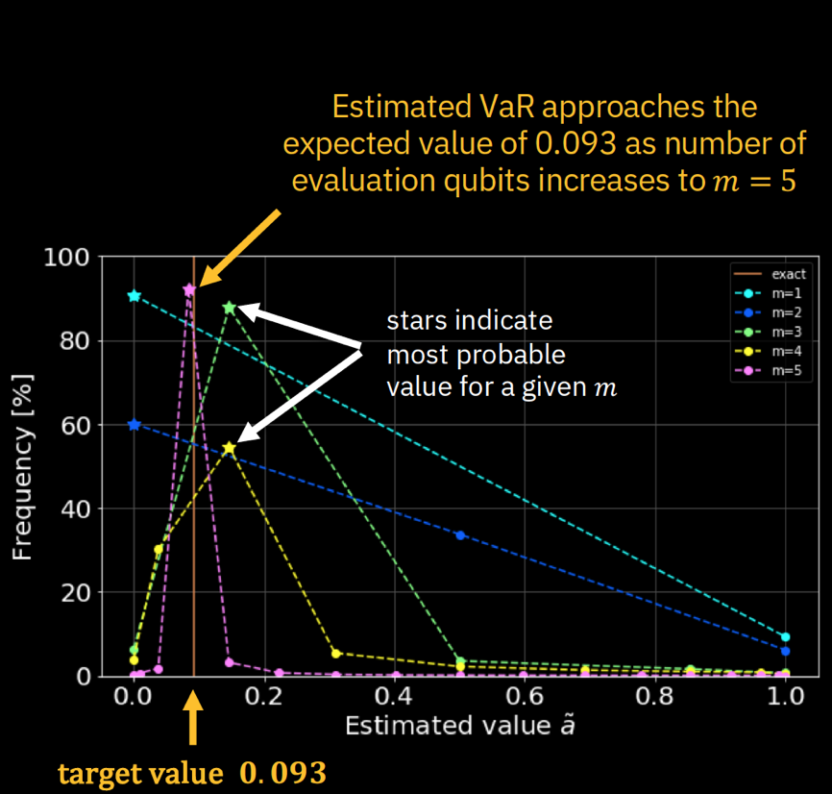
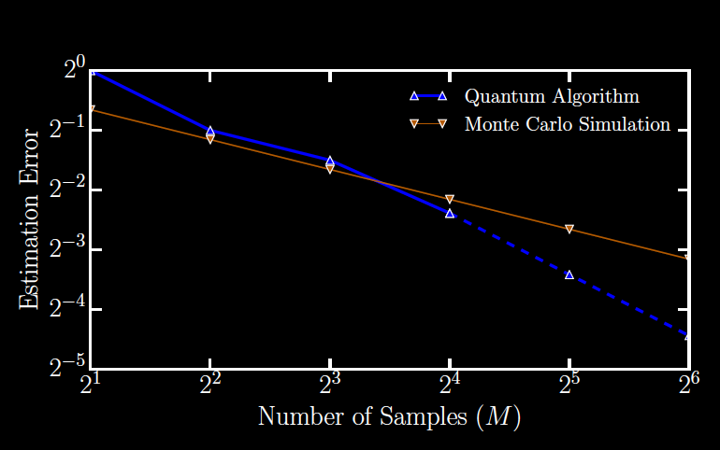

Quantum risk analysis
Example 1: Expected Value of a T-bill
Example 2: Value at Risk of a two asset portfolio
Estimation error with quantum algorithm lower than Monte Carlo simulations with =4 evaluation qubits
arXiv: 1806.06893 (2018)
Stefan Woerner, Daniel Egger, IBM Research- Zurich

Slide 15

Outlook and conclusion
Current status
Proof of concept algorithms developed
identifying industry-relevant problems
Current and future research
Improve existing algorithms e.g. reduce circuit depth
Identify new quantum algorithms
Improve hardware – deep circuits and many qubits needed
Study the scaling of quantum algorithms for industry-relevant problems
Bottom line
Potential still needs to be realized

